Slide 1

Front End Engineering – II Project
Chitkara University Institute of Engineering and Technology,
Chitkara University, Punjab
SUBMITTED BY:
Jiya : 2210990463
Kartik Bhardwaj : 2210990487
Kartik Grover : 2210990488
SUBMITTED TO:
Dr. Baljit Kaur
Mr. Vikas Patel

Slide 2
TABLE OF CONTENT
INTRODUCTION
PROBLEM STATEMENT
TECHNICAL DETAILS
KEY FEATURES
PROJECT GOALS
CONCLUSION
REFERENCES

Slide 3
TECHNICAL
DETAILS
KEY
FEATURES
PROJECT GOALS
CONCLUSION
REFERENCES
PROBLEM STATEMENT
PumpWiki : Guide For Your Fitness and Wellness
Welcome to PumpWiki, where your journey to a healthier, fitter lifestyle begins. In a world where health and wellness are paramount, we understand the challenges individuals face in achieving their fitness goals. That's why we've created PumpWiki.
We believe that fitness is not just about physical appearance; it's about feeling strong, confident, and energized from the inside out. Our mission is to inspire and guide you every step of the way.
INTRODUCTION

Slide 4
TECHNICAL
DETAILS
KEY
FEATURES
PROJECT GOALS
CONCLUSION
REFERENCES
Making up our mind to be fit is easy but maintaining that consistency can be a challenge. As A person entering into his/her fitness journey can raise a lot of questions on how to start, what to do.
PumpWiki provides you a platform where you get personalised support to meet your goals. Beginners do not need to worry about what to do as we provide them with a pre prepared playlist of workouts which demonstrates each and every workout.
PROBLEM
STATEMENT
PumpWiki : Guide For Your Fitness and Wellness
Welcome to PumpWiki, where your journey to a healthier, fitter lifestyle begins. In a world where health and wellness are paramount, we understand the challenges individuals face in achieving their fitness goals. That's why we've created PumpWiki.
We believe that fitness is not just about physical appearance; it's about feeling strong, confident, and energized from the inside out. Our mission is to inspire and guide you every step of the way.
INTRODUCTION

Slide 5
KEY
FEATURES
PROJECT
GOALS
CONCLUSION
REFERENCES
HTML:The HTML structure includes a basic layout with a header, navigation bar, and main content area. You can customize and expand upon this structure to create your fitness website
CSS:Targeting the HTML elements and applying styles to them using selectors. To control the layout, design, colors, fonts, and other visual aspects of a webpage.
TECHNICAL
DETAILS
INTRODUCTION
PROBLEM
STATEMENT
PumpWiki : Guide For Your Fitness and Wellness
Welcome to PumpWiki, where your journey to a healthier, fitter lifestyle begins. In a world where health and wellness are paramount, we understand the challenges individuals face in achieving their fitness goals. That's why we've created PumpWiki.
We believe that fitness is not just about physical appearance; it's about feeling strong, confident, and energized from the inside out. Our mission is to inspire and guide you every step of the way.

Slide 6
KEY
FEATURES
PROJECT
GOALS
CONCLUSION
REFERENCES
JAVASCRIPT:To create dynamic and interactive content on websites. Allows developers to add interactivity, functionality, and behavior to web pages. It can manipulate the HTML and CSS of a webpage in real-time.
REACT: A popular JavaScript library for building for creating dynamic and interactive web applications. It performs necessary manipulations within this virtual representation before applying changes to the actual browser DOM. React is efficient, altering only what requires modification.
TECHNICAL
DETAILS
INTRODUCTION
PROBLEM
STATEMENT
PumpWiki : Guide For Your Fitness and Wellness
Welcome to PumpWiki, where your journey to a healthier, fitter lifestyle begins. In a world where health and wellness are paramount, we understand the challenges individuals face in achieving their fitness goals. That's why we've created PumpWiki.
We believe that fitness is not just about physical appearance; it's about feeling strong, confident, and energized from the inside out. Our mission is to inspire and guide you every step of the way.

Slide 7
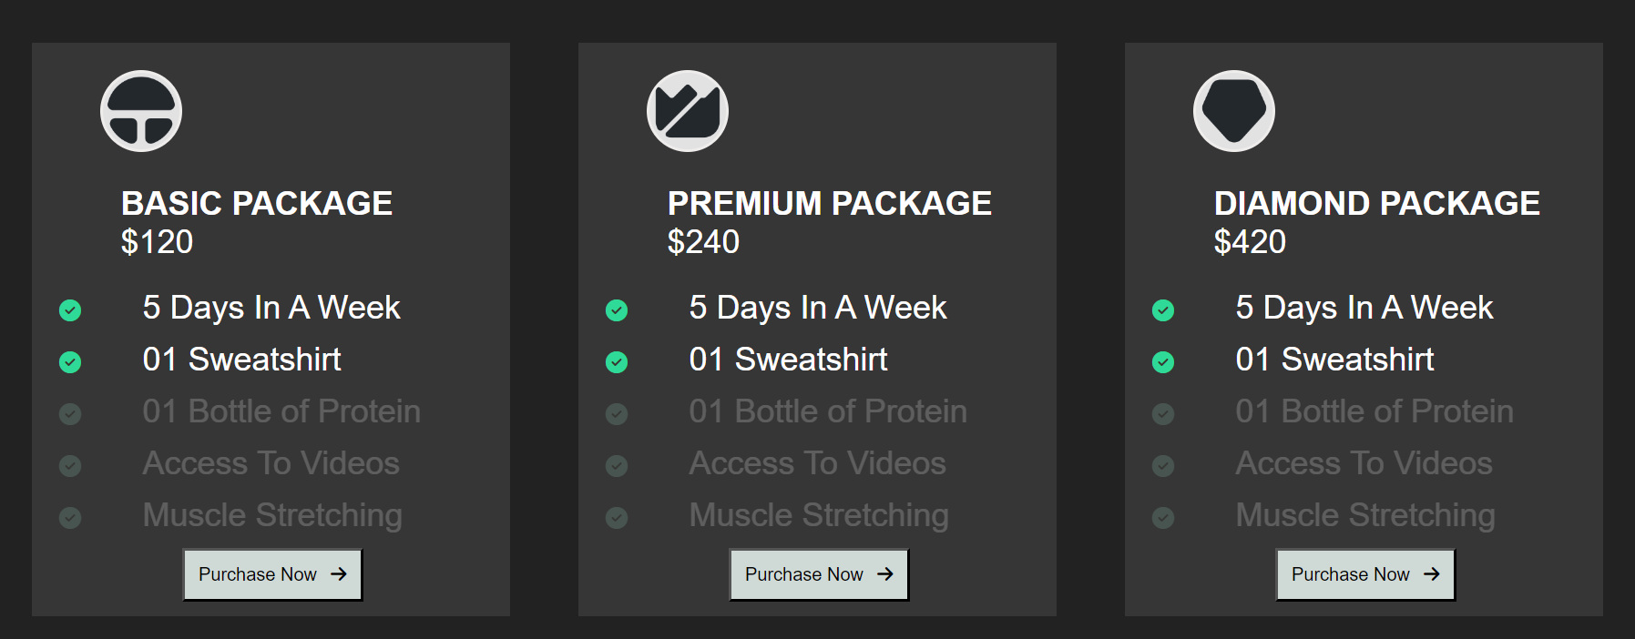
HOW REACT COMPONENTS WORKS?

Slide 8
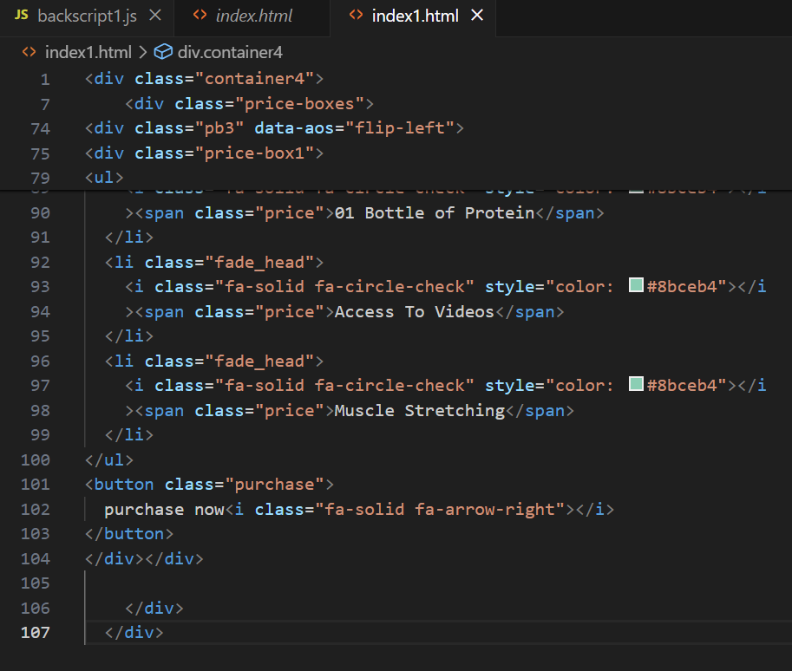
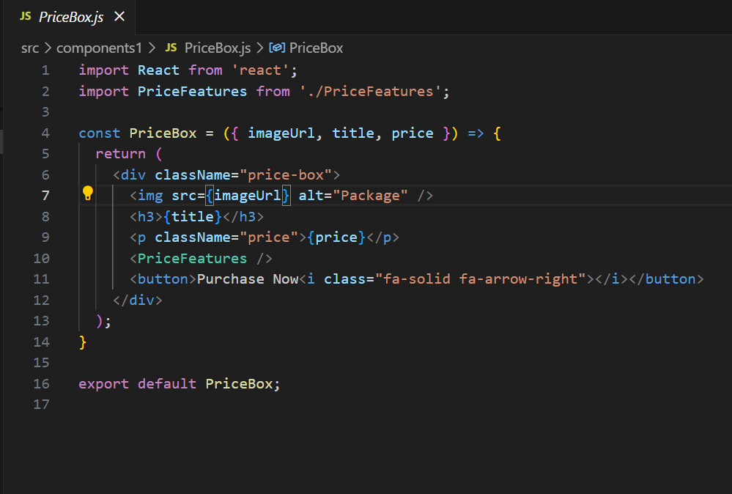
Why React over JavaScript?
JavaScript
React

Slide 9
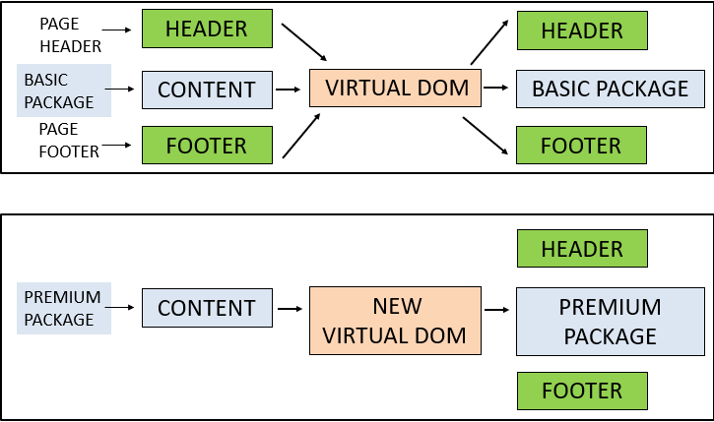
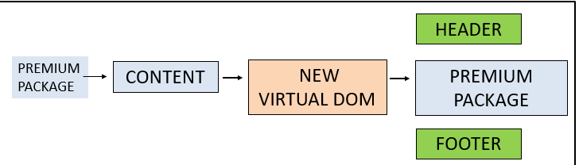

Slide 10
PROJECT
GOALS
CONCLUSION
REFERENCES
This Website provides you a complete playlist of workout with visual demonstration of how to perform.
It has a BMI Calculator which will tell you about your body mass
You can join our programs and you will be well notified as confirmations will be sent to your mail.
You can resume and stop whenever you want as we have made this site more interactive.
PROBLEM
STATEMENT
KEY
FEATURES
INTRODUCTION
SAEWORIJDFNMSAL;SWPOERDKJFCXM,ZS.
SAEWORIJDFNMSAL;SWPOERDKJFCXM,ZS.
TECHNICAL
DETAILS

Slide 11
CONCLUSION
REFERENCES
Provide users with a user-friendly and intuitive mobile app for tracking fitness activities and achieving health goals.
Foster a supportive and engaging community where users can connect, share experiences, and motivate each other.
Help users improve their overall health and wellness through personalized workout plans, nutrition tracking, and progress monitoring.
To grow a bigger community of people who use this website to inspire and grow together.
PROBLEM
STATEMENT
PROJECT
GOALS
INTRODUCTION
This Website provides you a complete playlist of workout with visual demonstration of how to perform.
It has a BMI Calculator which will tell you about your body mass
You can join our programs and you will be well notified as confirmations will be sent to your mail.
You can resume and stop whenever you want as we have made this site more interactive.
SAEWORIJDFNMSAL;SWPOERDKJFCXM,ZS.
SAEWORIJDFNMSAL;SWPOERDKJFCXM,ZS.
KEY
FEATURES
TECHNICAL
DETAILS

Slide 12
In conclusion, PumpWiki is poised to revolutionize the way users approach their health and fitness journey. With its comprehensive set of features, personalized approach, and commitment to user empowerment, the app aims to empower individuals of all fitness levels to take control of their health and achieve their wellness goals. Together, we look forward to helping individuals worldwide embark on their fitness journey and unlock their full potential. Get ready to track, train, and transform with PumpWiki – because your health and wellness journey starts here.
REFERENCES
PROBLEM
STATEMENT
CONCLUSION
INTRODUCTION
This Website provides you a complete playlist of workout with visual demonstration of how to perform.
It has a BMI Calculator which will tell you about your body mass
You can join our programs and you will be well notified as confirmations will be sent to your mail.
You can resume and stop whenever you want as we have made this site more interactive.
PROJECT
GOALS
Provide users with a user-friendly and intuitive mobile app for tracking fitness activities and achieving health goals.
Foster a supportive and engaging community where users can connect, share experiences, and motivate each other.
Help users improve their overall health and wellness through personalized workout plans, nutrition tracking, and progress monitoring.
To grow a bigger community of people who use this website to inspire and grow together.
SAEWORIJDFNMSAL;SWPOERDKJFCXM,ZS.
SAEWORIJDFNMSAL;SWPOERDKJFCXM,ZS.
KEY
FEATURES
TECHNICAL
DETAILS

Slide 13
Bootstrap retrieved from - https://getbootstrap.com/
Video reference retrieved from - https://www.youtube.com/watch?v=ddaY0rHqMxM
Icons retrieved from - https://fontawesome.com/icons
Font retrieved from -
https://fonts.google.com/
Animation retrieved from -
https://michalsnik.github.io/aos/
https://github.com/michalsnik/aos
PROBLEM
STATEMENT
REFERENCES
INTRODUCTION
This Website provides you a complete playlist of workout with visual demonstration of how to perform.
It has a BMI Calculator which will tell you about your body mass
You can join our programs and you will be well notified as confirmations will be sent to your mail.
You can resume and stop whenever you want as we have made this site more interactive.
PROJECT
GOALS
Provide users with a user-friendly and intuitive mobile app for tracking fitness activities and achieving health goals.
Foster a supportive and engaging community where users can connect, share experiences, and motivate each other.
Help users improve their overall health and wellness through personalized workout plans, nutrition tracking, and progress monitoring.
To grow a bigger community of people who use this website to inspire and grow together.
SAEWORIJDFNMSAL;SWPOERDKJFCXM,ZS.
SAEWORIJDFNMSAL;SWPOERDKJFCXM,ZS.
In conclusion, PumpWiki is poised to revolutionize the way users approach their health and fitness journey. With its comprehensive set of features, personalized approach, and commitment to user empowerment, the app aims to empower individuals of all fitness levels to take control of their health and achieve their wellness goals. Together, we look forward to helping individuals worldwide embark on their fitness journey and unlock their full potential. Get ready to track, train, and transform with PumpWiki – because your health and wellness journey starts here.
KEY
FEATURES
CONCLUSION
TECHNICAL
DETAILS

Slide 14
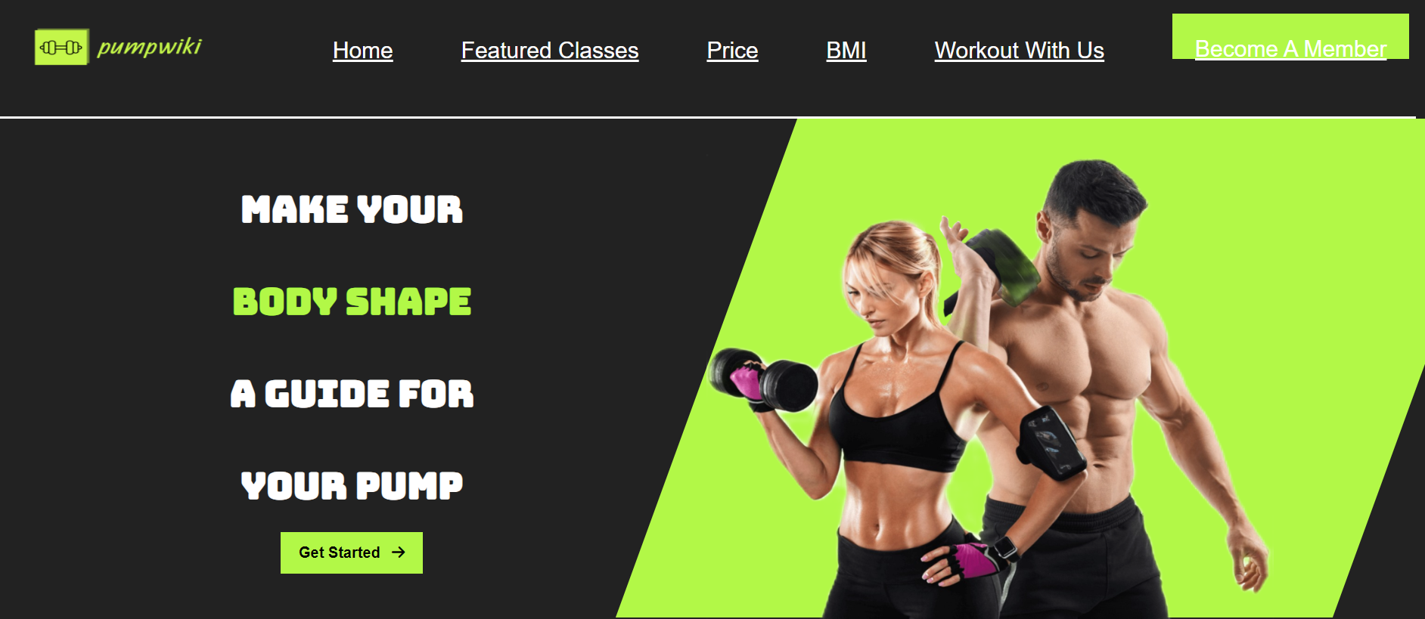
PROBLEM
STATEMENT
INTRODUCTION
REFERENCES
This Website provides you a complete playlist of workout with visual demonstration of how to perform.
It has a BMI Calculator which will tell you about your body mass
You can join our programs and you will be well notified as confirmations will be sent to your mail.
You can resume and stop whenever you want as we have made this site more interactive.
PROJECT
GOALS
Provide users with a user-friendly and intuitive mobile app for tracking fitness activities and achieving health goals.
Foster a supportive and engaging community where users can connect, share experiences, and motivate each other.
Help users improve their overall health and wellness through personalized workout plans, nutrition tracking, and progress monitoring.
To grow a bigger community of people who use this website to inspire and grow together.
SAEWORIJDFNMSAL;SWPOERDKJFCXM,ZS.
SAEWORIJDFNMSAL;SWPOERDKJFCXM,ZS.
In conclusion, PumpWiki is poised to revolutionize the way users approach their health and fitness journey. With its comprehensive set of features, personalized approach, and commitment to user empowerment, the app aims to empower individuals of all fitness levels to take control of their health and achieve their wellness goals. Together, we look forward to helping individuals worldwide embark on their fitness journey and unlock their full potential. Get ready to track, train, and transform with PumpWiki – because your health and wellness journey starts here.
Bootstrap retrieved from - https://getbootstrap.com/
Video reference retrieved from - https://www.youtube.com/watch?v=ddaY0rHqMxM
Icons retrieved from - https://fontawesome.com/icons
Font retrieved from -
https://fonts.google.com/
Animation retrieved from -
https://michalsnik.github.io/aos/
https://github.com/michalsnik/aos
KEY
FEATURES
CONCLUSION
TECHNICAL
DETAILS

Slide 15
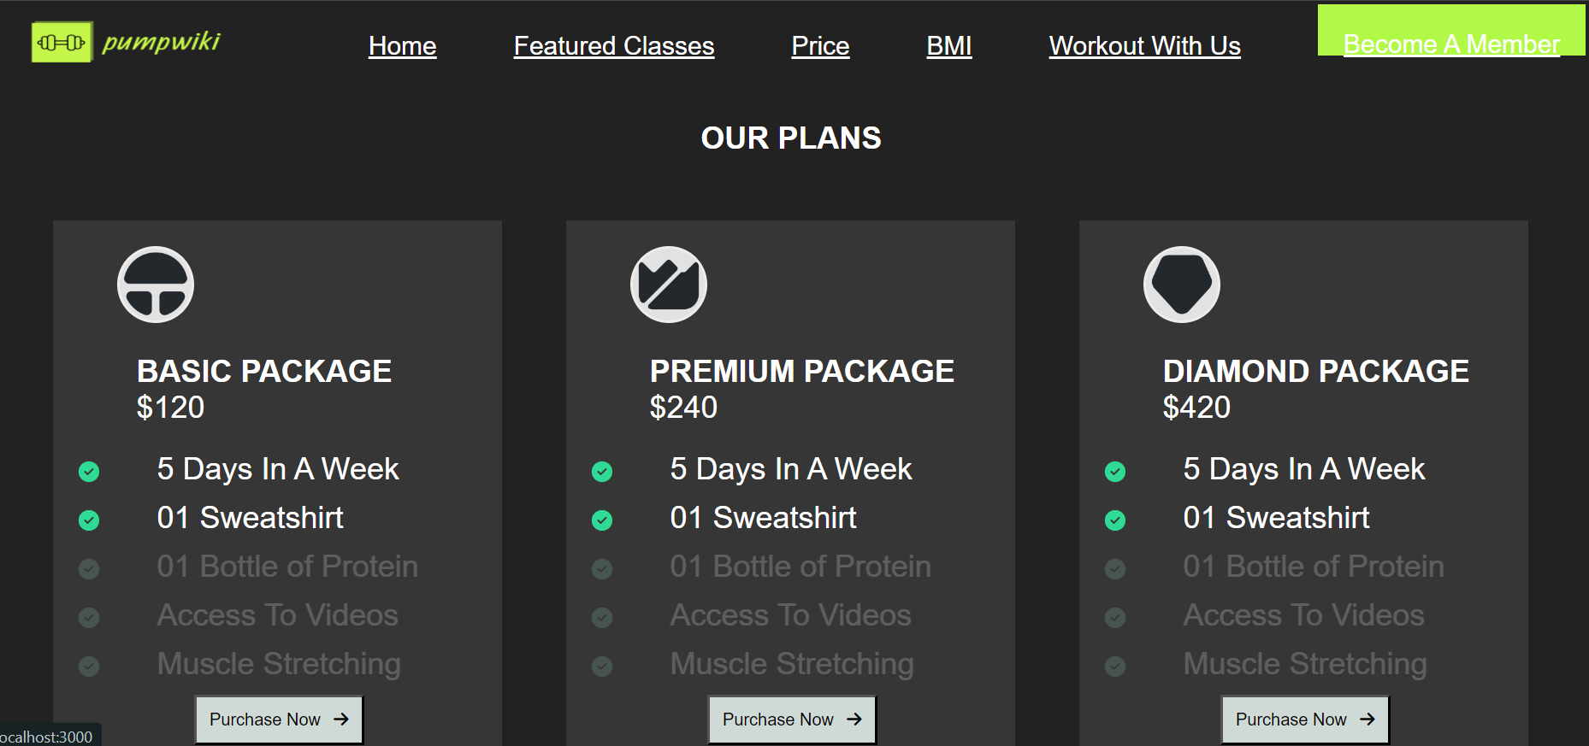

Slide 16
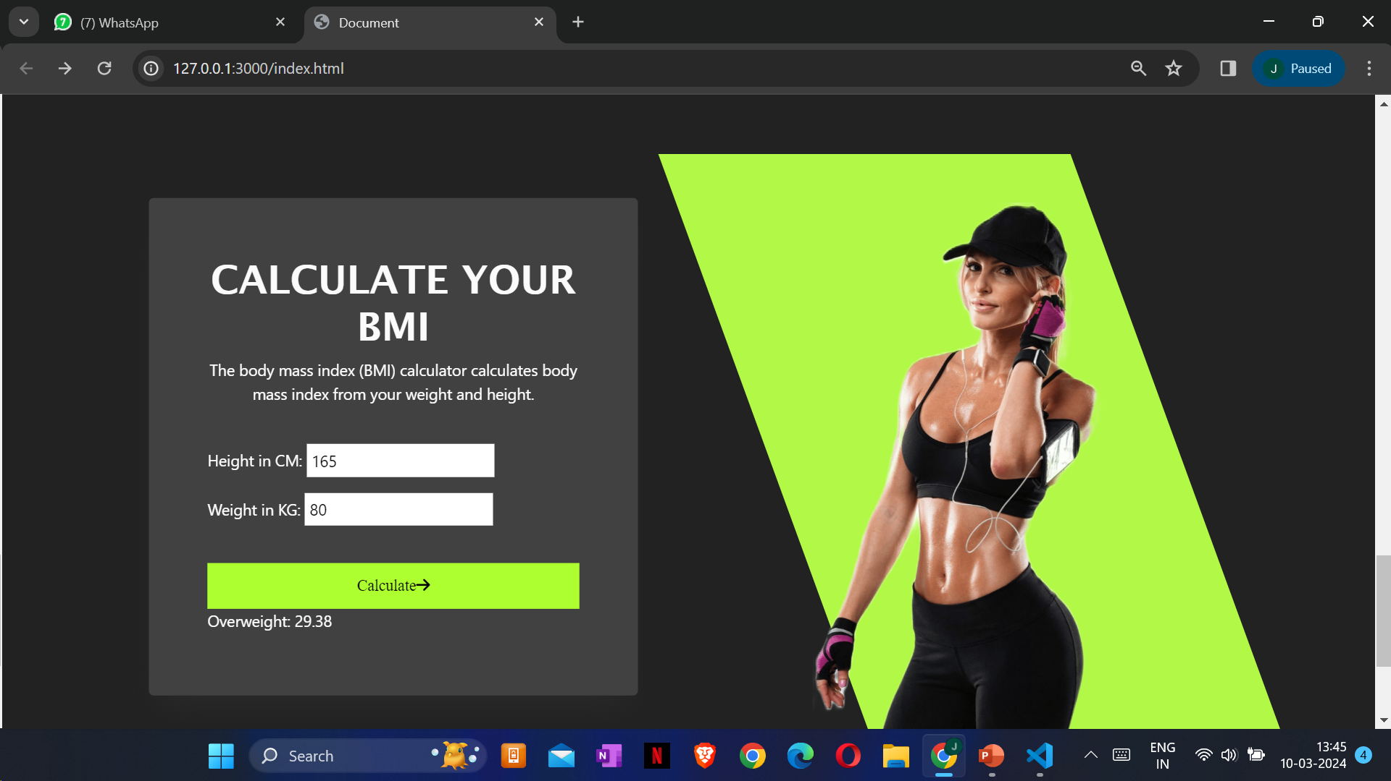

Slide 17
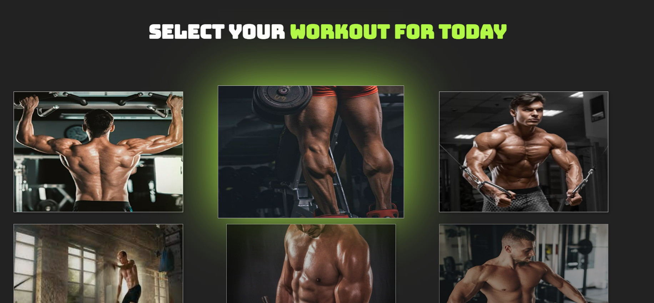

Slide 18
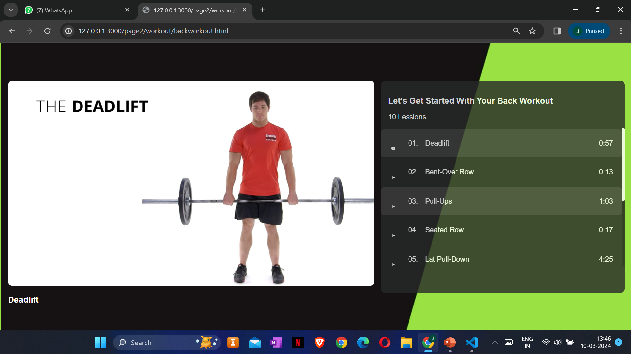

Slide 19
Thank You!
PROBLEM
STATEMENT
REFERENCES
INTRODUCTION
This Website provides you a complete playlist of workout with visual demonstration of how to perform.
It has a BMI Calculator which will tell you about your body mass
You can join our programs and you will be well notified as confirmations will be sent to your mail.
You can resume and stop whenever you want as we have made this site more interactive.
PROJECT
GOALS
Provide users with a user-friendly and intuitive mobile app for tracking fitness activities and achieving health goals.
Foster a supportive and engaging community where users can connect, share experiences, and motivate each other.
Help users improve their overall health and wellness through personalized workout plans, nutrition tracking, and progress monitoring.
To grow a bigger community of people who use this website to inspire and grow together.
SAEWORIJDFNMSAL;SWPOERDKJFCXM,ZS.
SAEWORIJDFNMSAL;SWPOERDKJFCXM,ZS.
Bootstrap retrieved from - https://getbootstrap.com/
Video reference retrieved from - https://www.youtube.com/watch?v=ddaY0rHqMxM
Icons retrieved from - https://fontawesome.com/icons
Font retrieved from -
https://fonts.google.com/
Animation retrieved from -
https://michalsnik.github.io/aos/
https://github.com/michalsnik/aos
In conclusion, PumpWiki is poised to revolutionize the way users approach their health and fitness journey. With its comprehensive set of features, personalized approach, and commitment to user empowerment, the app aims to empower individuals of all fitness levels to take control of their health and achieve their wellness goals. Together, we look forward to helping individuals worldwide embark on their fitness journey and unlock their full potential. Get ready to track, train, and transform with PumpWiki – because your health and wellness journey starts here.
KEY
FEATURES
CONCLUSION
TECHNICAL
DETAILS

